Slide 1
Extended Learning Time:
Data Overview
Carin Reeve-Larham, Principal
Dr. Weeks Elementary School
Notes:
Carin will introduce the presentation and the team
Share brief leadership story - how I came to Dr. Weeks

Slide 2
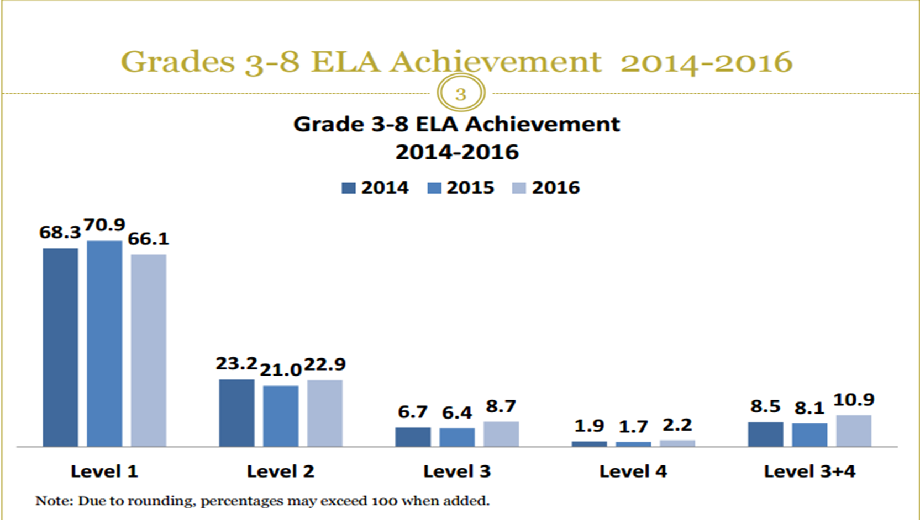
#Results
Notes:
NYS Assessment scores have increased - targeted coaching, school-wide instructional strategies, and data-driven instructional planning during Collaborative Team Planning are demonstrating results. The data from NYS Assessments is used during collaborative team planning as one data point (as well as Achievement Network, STAR Assessments, Writing Common Formative Assessments, and Running Records) to identify gaps in student learning and teacher instructional practices. Next steps in terms of teacher actions are developed during Collaborative Team Planning.

Slide 3
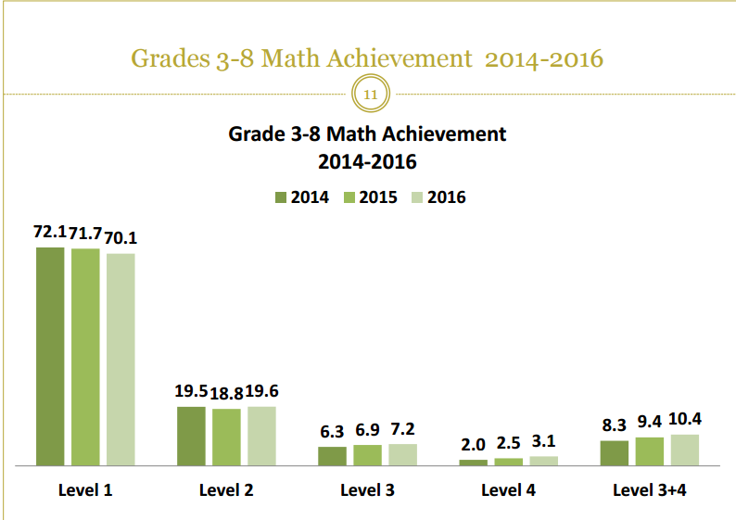
#Results

Slide 4
#Results

Slide 5
#Results

Slide 6
#Results
Notes:
Our results from summer academy demonstrate that our programming prevented regression and led to student growth

Slide 7
#Results
Notes:
Our results from summer academy demonstrate that our programming prevented regression and led to student growth

Slide 8
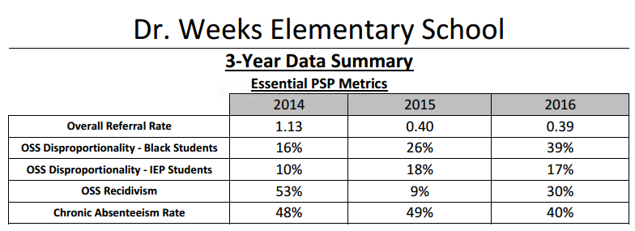
#Results
Notes:
Our results from summer academy demonstrate that our programming prevented regression and led to student growth

Slide 9
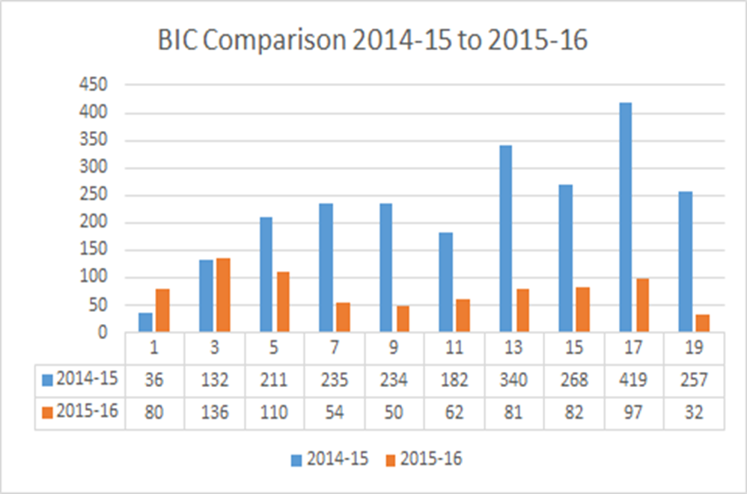
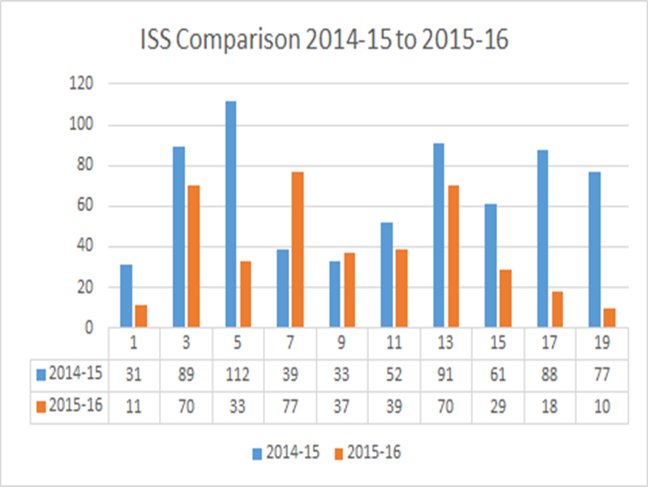
#Results
Notes:
Our results from summer academy demonstrate that our programming prevented regression and led to student growth

